Slide 1

SGLT2 INHIBITORS IN PATIENTS WITH HEART FAILURE: A COMPREHENSIVE META-ANALYSIS OF FIVE RANDOMISED CONTROLLED TRIALS
SGLT2 inhibitors are strongly recommended in guidelines to treat patients with heart failure with reduced ejection fraction, but their clinical benefits at higher ejection fractions are less well established. Two large-scale trials, DELIVER and EMPEROR-Preserved, in heart failure with mildly reduced or preserved ejection fraction have been done, providing power to examine therapeutic effects on cardiovascular mortality and in patient subgroups when combined with the earlier trials in reduced ejection fraction.

Slide 2

METHODS
WE DID A PRESPECIFIED META-ANALYSIS OF DELIVER AND EMPEROR-PRESERVED, AND SUBSEQUENTLY INCLUDED TRIALS THAT ENROLLED PATIENTS WITH REDUCED EJECTION FRACTION (DAPA-HF AND EMPEROR-REDUCED) AND THOSE ADMITTED TO HOSPITAL WITH WORSENING HEART FAILURE.
IRRESPECTIVE OF EJECTION FRACTION (SOLOIST-WHF). USING TRIAL-LEVEL DATA WITH HARMONISED ENDPOINT DEFINITIONS
WE DID A FIXED-EFFECTS META-ANALYSIS TO ESTIMATE THE EFFECT OF SGLT2 INHIBITORS ON VARIOUS CLINICAL ENDPOINTS IN HEART FAILURE
THE PRIMARY ENDPOINT FOR THIS META- ANALYSIS WAS TIME FROM RANDOMISATION TO THE OCCURRENCE OF THE COMPOSITE OF CARDIOVASCULAR DEATH OR HOSPITALISATION FOR HEART FAILURE.
WE ASSESSED HETEROGENEITY IN TREATMENT EFFECTS FOR THE PRIMARY ENDPOINT ACROSS SUBGROUPS OF INTEREST.

Slide 3
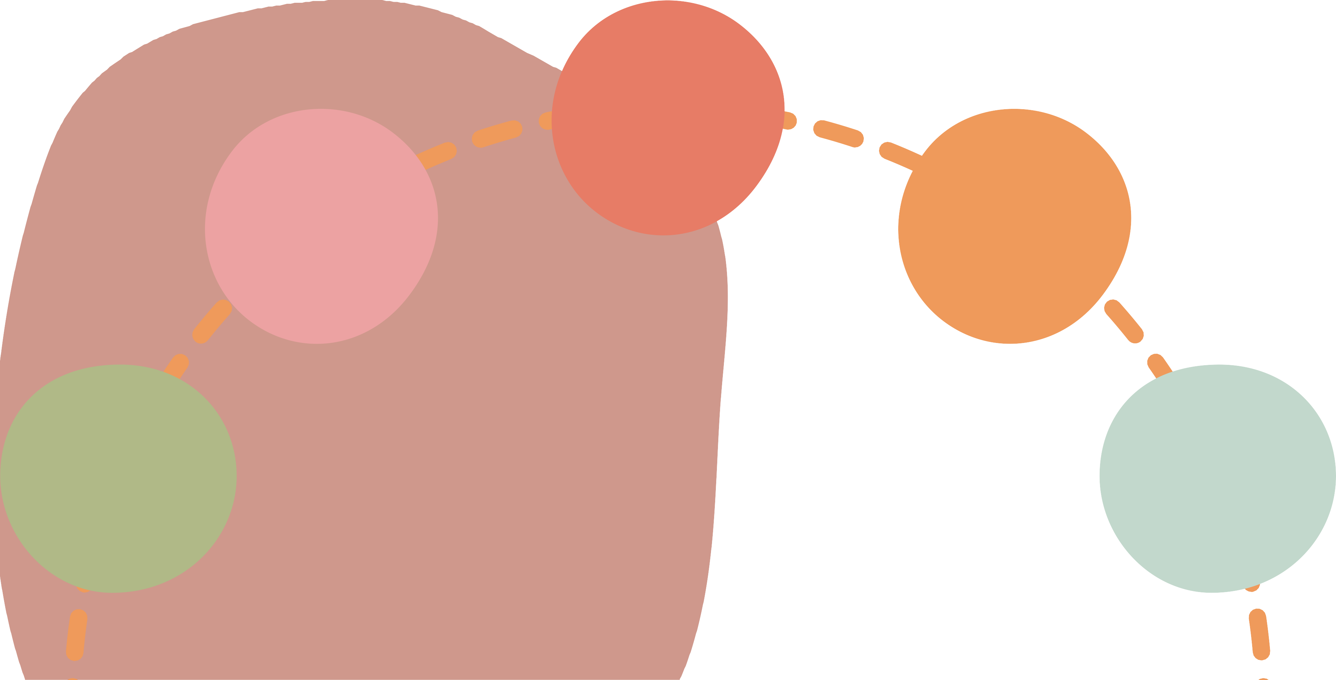
FINDINGS
S IN THE BROADER CONTEXT OF THE FIVE TRIALS OF 21 947 PARTICIPANTS, SGLT2 INHIBITORS REDUCED THE RISK OF COMPOSITE
CARDIOVASCULAR DEATH OR HOSPITALISATION FOR HEART FAILURE (0·77 [0·72–0·82]), CARDIOVASCULAR DEATH
(HAZARD RATIO 0·80 [95% CI 0·73–0·87]) WITH
(0·87 [0·79–0·95]), FIRST
THESE TREATMENT EFFECTS FOR EACH OF THE
HOSPITALISATION FOR HEART FAILURE (0·72 [0·67–0·78]), AND ALL-CAUSE MORTALITY (0·92 [0·86–0·99])
CONSISTENT REDUCTIONS
STUDIED ENDPOINTS WERE CONSISTENTLY OBSERVED IN BOTH THE TRIALS OF HEART FAILURE WITH MILDLY REDUCED OR
IN BOTH COMPONENTS: CARDIOVASCULAR DEATH (0·88 [0·77–1·00]) AND
FIRST HOSPITALISATION FOR HEART FAILURE (0·74 [0·67–0·83])
PRESERVED EJECTION FRACTION AND ACROSS ALL FIVE TRIALS
CONCLUSION
SGLT2 inhibitors reduced the risk of cardiovascular death and hospitalisations for heart failure in a broad range of patients with heart failure, supporting their role as a foundational therapy for heart failure, irrespective of ejection fraction or care setting.
AMONG 12 251 PARTICIPANTS FROM DELIVER AND EMPEROR- PRESERVED, SGLT2 INHIBITORS REDUCED COMPOSITE
TREATMENT EFFECTS ON THE PRIMARY ENDPOINT
WERE
GENERALLY ACROSS SUBGROUPS
CARDIOVASCULAR DEATH OR
CONSISTENT THE 14
FIRST HOSPITALISATION FOR HEART FAILURE
EXAMINED, INCLUDING EJECTION FRACTION

