Slide 1


Empagliflozin and serum potassium in heart failure: an analysis from EMPEROR-Pooled
Hyperkalaemia frequently leads to interruption and discontinuation of neurohormonal antagonists, which may worsen heart failure prognosis. Some studies suggested that sodium-
glucose cotransporter 2 inhibitors reduce
have
hyperkalaemia, an effect that may
important clinical implications. This analysis evaluates the effect of empagliflozin on the occurrence of hyper- and hypokalaemia in HF.

Slide 2
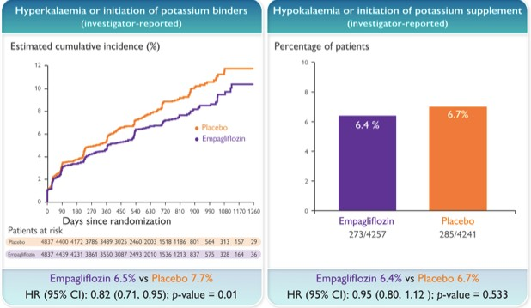
Empagliflozin reduced the incidence of hyperkalemia without increasing the risk of hypokalemia.
Empagliflozin reduces the incidence of hyperkalaemia, without significant increase in hypokalaemia, in patients with heart failure across the full range of ejection fraction.

Slide 3
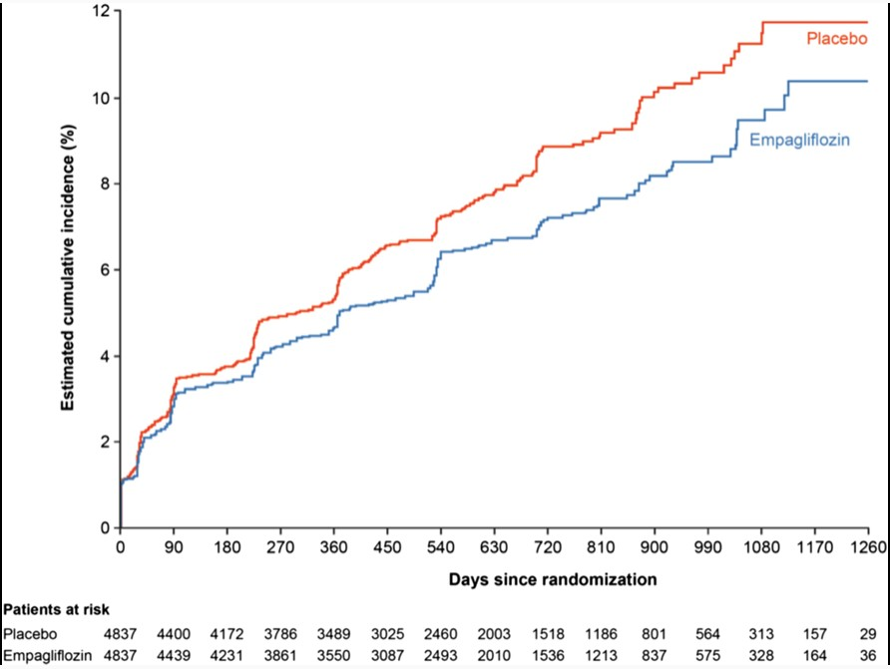
Effect of empagliflozin on potassium-related outcomes and safety
Effect of empagliflozin on the incidence of investigator-reported hyperkalaemia or initiation of potassium binders. Considering all-cause mortality as a competing risk and only including patients not receiving potassium-binding agents at baseline.

Slide 4
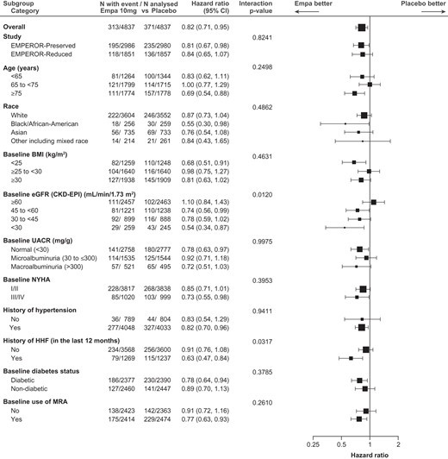
Effect of empagliflozin on potassium-related outcomes and safety
Effect of empagliflozin on investigator-reported hyperkalaemia or the initiation of potassium binders in subgroups of interest. Based on Cox proportional hazard model adjusted for age (continuous), baseline estimated
glomerular filtration rate (continuous), baseline left
(continuous), study, region,
ventricular ejection fraction
baseline diabetes status, sex, treatment, subgroup, and subgroup and treatment interaction. In subgroups with more than two categories (except for race), an interaction trend test was performed. BMI, body mass index; CI, confidence interval; CKD-EPI, Chronic Kidney Disease Epidemiology Collaboration; eGFR, estimated glomerular filtration rate; Empa, empagliflozin; HHF, hospitalization for heart failure; MRA, mineralocorticoid receptor antagonist; NYHA, New York Heart Association; UACR, urine albumin-to- creatinine ratio.

Slide 5
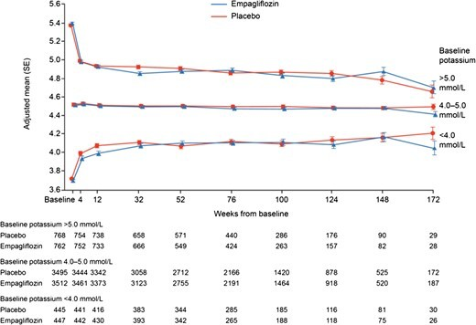
Effect of empagliflozin on potassium-related outcomes and safety
Effect of empagliflozin on potassium over time by baseline potassium. All P-values for the treatment differences are >0.05; except for baseline potassium < 4.0 mmol/L: week 12 (P < 0.05), baseline potassium 4.0–5.0 mmol/L: week 172 (P < 0.05), baseline potassium > 5.0 mmol/L: week 32 (P < 0.001). Based on mixed model repeated measures analysis. All covariate effects are set equal to their mean values within subgroup for the calculation of adjusted means.

Slide 6

RESULTS
Empagliflozin (compared with placebo) reduced the composite of investigator-reported hyperkalaemia or initiation of potassium binders [6.5% vs. 7.7%, hazard ratio (HR) 0.82, 95% confidence interval (CI) 0.71–0.95, P = 0.01].
Empagliflozin reduced hyperkalaemia rates regardless of the definition used (serum potassium >5.5 mmol/l: 8.6% vs. 9.9%, HR 0.85, 95% CI 0.74–0.97, P = 0.017; serum potassium >6.0 mmol/l: 1.9% vs. 2.9%, HR 0.62, 95% CI 0.48–0.81, P < 0.001).
The incidence of hypokalaemia (investigator-reported or serum potassium <3.0 mmol/l) was not significantly increased with empagliflozin.
CONCLUSION
Empagliflozin reduced the incidence of hyperkalaemia without a significant increase in hypokalaemia.

