Slide 1


Effects of aspirin on dementia
and cognitive function in diabetic patients:
The ASCEND trial
t Started

Slide 2
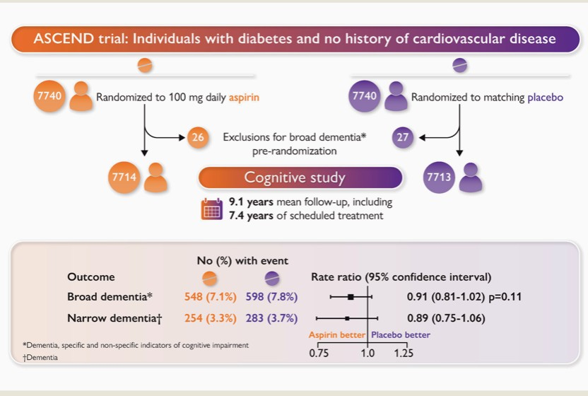

The effect of aspirin on dementia in the ASCEND trial: Study design and summary results.
Aspirin does not result in a large (>19%) proportional reduction in dementia risk. Trials or meta-analyses with
more incident dementia cases are needed to assess whether modest proportional 10-15% benefits of aspirin on dementia exist.
Next Page

Slide 3



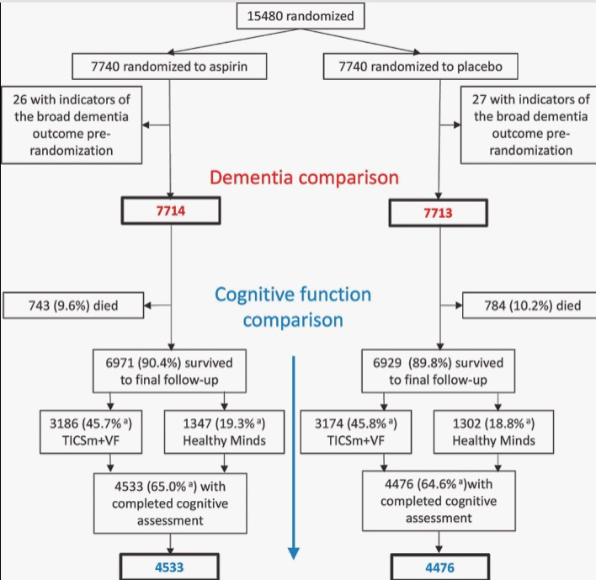
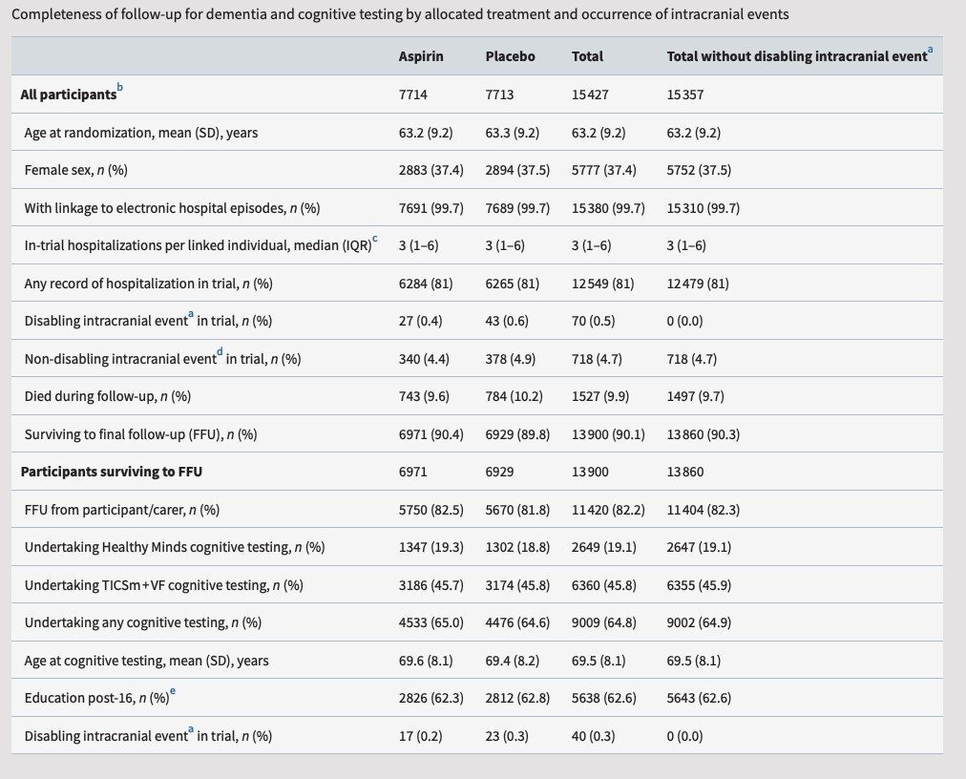
Dementia and Cognitive Impairment outcomes

Slide 4

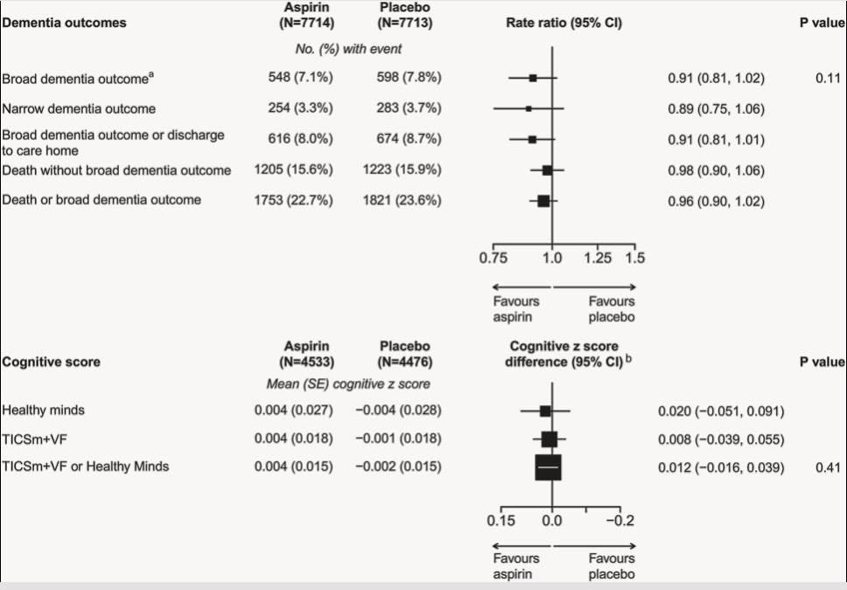
Randomized effects of aspirin on dementia outcomes
Read more

Slide 5

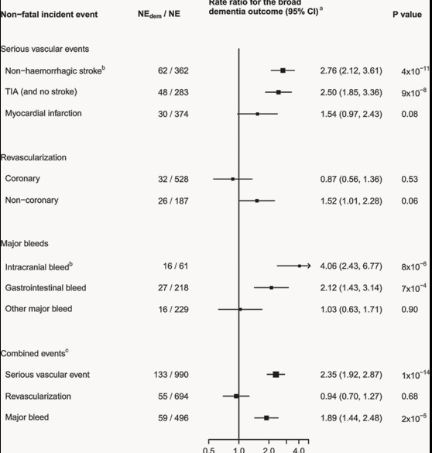
Observational associations of in-trial incident events with subsequent dementia and cognitive ageing
Read more

Slide 6



CONCLUSION
Allocation to aspirin for a mean of 7.4 years was not associated with any statistically
significant differences in the risk of
net
dementia and the results excluded
proportional benefits of 19% or more.
This is consistent with findings in the small number of other trials that have investigated the effects of aspirin on dementia.
Trials or meta-analyses of trials with larger numbers of incident dementia cases would provide greater statistical power to assess whether any modest proportional 10–15% benefits of 5–7 years of aspirin use on dementia exist, which might translate into greater cumulative absolute benefits of longer-term use.
Next Page

