Slide 1
Cardiovascular and Renal Outcomes
with Efpeglenatide in Type 2 Diabetes
F o u r g l u c a g o n - l i k e p e p t i d e - 1 ( G L P - 1 ) r e c e p t o r a g o n i s t s t h a t a r e s t r u c t u r a l l y
s i m i l a r t o h u m a n G L P - 1 h a v e b e e n s h o w n t o r e d u c e t h e r i s k o f a d v e r s e
c a r d i o v a s c u l a r e v e n t s a m o n g p e r s o n s w i t h t y p e 2 d i a b e t e s . T h e e f f e c t o f a n e x e n d i n - b a s e d G L P - 1 r e c e p t o r a g o n i s t ,
e f p e g l e n a t i d e , o n c a r d i o v a s c u l a r a n d r e n a l o u t c o m e s i n p a t i e n t s w i t h t y p e 2 d i a b e t e s w h o a r e a l s o a t h i g h r i s k f o r a d v e r s e
c a r d i o v a s c u l a r e v e n t s i s u n c e r t a i n .

Slide 2
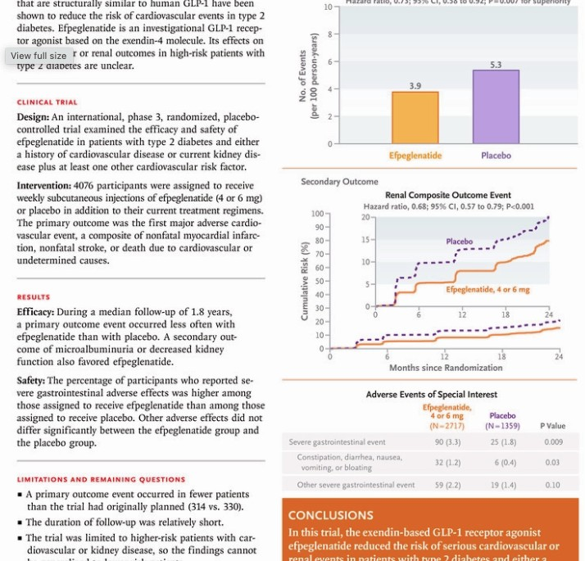
Cardiovascular and Renal Outcomes
with Efpeglenatide in Type 2 Diabetes

Slide 3
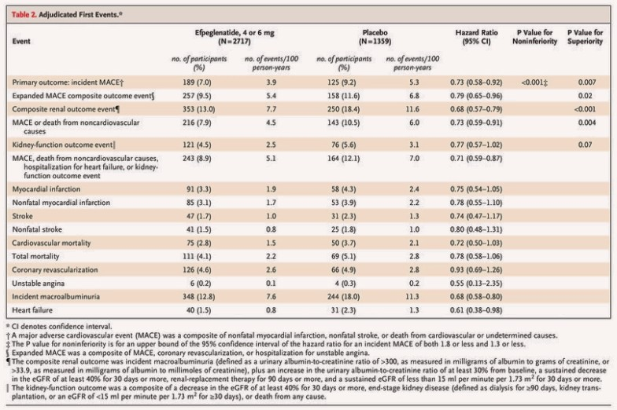
Adjudicated First Events

Slide 4
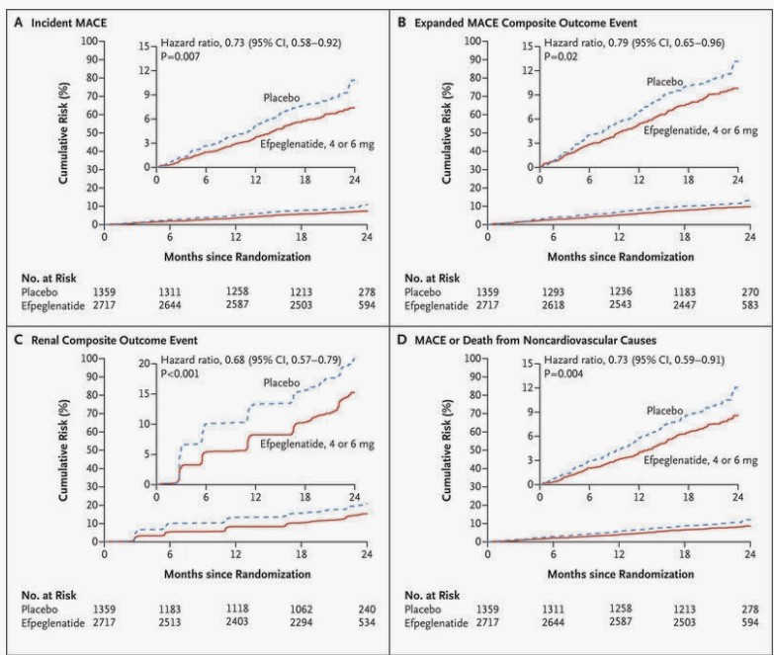
Major Cardiovascular and Renal Outcomes

Slide 5

Prespecified Subgroup Analyses of Incident MACE
(the Primary Efficacy Outcome)

Slide 6
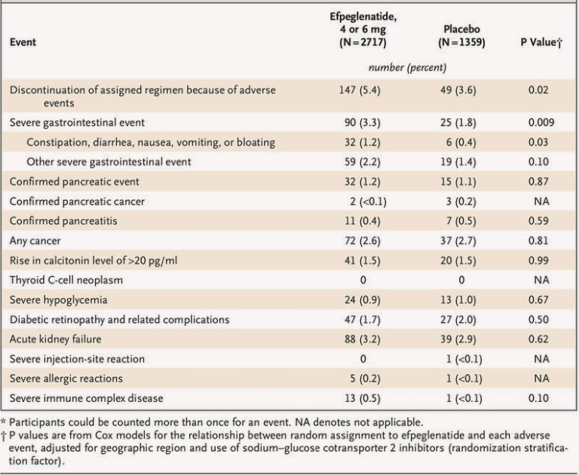
Adverse Events of Special Interest

Slide 7


RESULTS
Occurred In
Empagliflozin Group
353 Participants
Composite Renal Outcome
Placebo Group
250 Participants
Empagliflozin Group
Placebo Group
Vomiting
Constipation
Diarrhoea
Diarrhoea
Constipation
Vomiting

Slide 8
CONCLUSION
In this trial involving participants with type 2 diabetes who had either a history of cardiovascular disease or current kidney disease plus at least one other cardiovascular risk factor, the risk of cardiovascular events was lower among those who received weekly subcutaneous injections of efpeglenatide at a dose of 4 or 6 mg than among those who received placebo.

