Slide 1
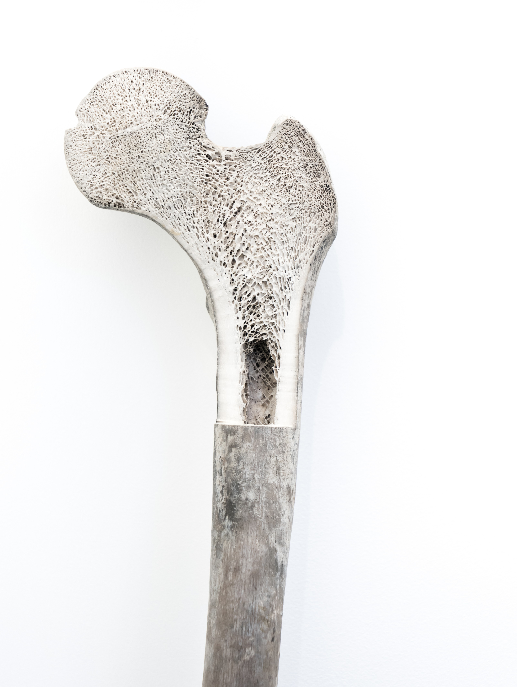
Bone marrow activation in response to metabolic syndrome and early atherosclerosis
Experimental studies suggest that increased bone marrow (BM) activity is involved in the association between cardiovascular risk factors and inflammation in atherosclerosis. However, human data to support this association are sparse. The purpose was to study the association between cardiovascular risk factors, BM activation, and subclinical atherosclerosis.

Slide 2
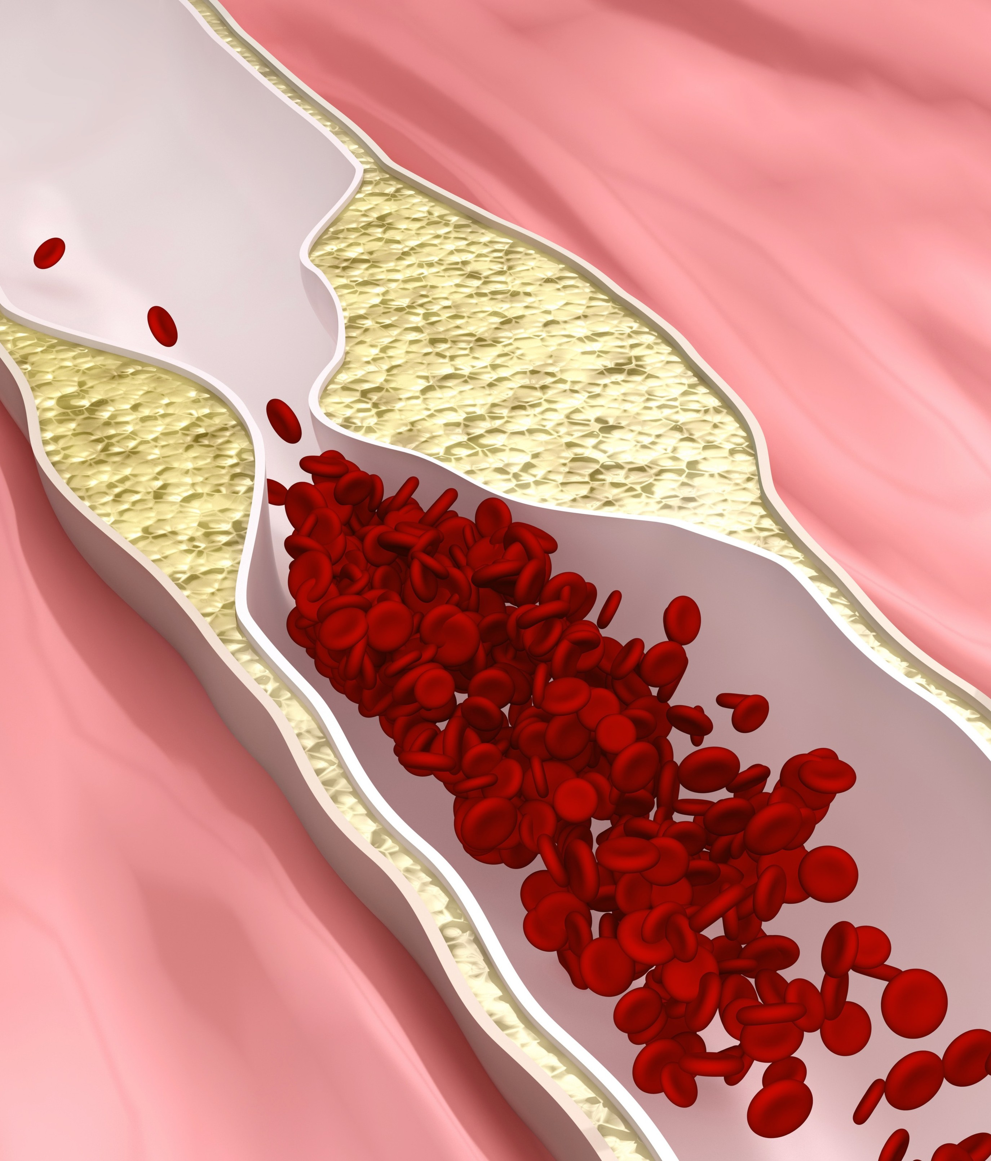

Factors leading to atherosclerotic process
After an acute cardiovascular event, BM is activated by sympathetic signalling, triggering an increased haematopoiesis, and the release of progenitor cells that activate spleen production of monocytes, aggravating atherosclerosis progression
Circulating immune cells play a critical role in the build-up of atherosclerotic plaques by adhering to activated endothelium and infiltrating the arterial wall to become lesional cells
Hypertension, driven by an overactive sympathetic activation, deteriorates the haematopoietic cell niche in the BM which can contribute to atherosclerosis.
chronic stress accelerates haematopoiesis, giving rise to higher levels of inflammatory cells that might contribute to the atherosclerotic process

Slide 3
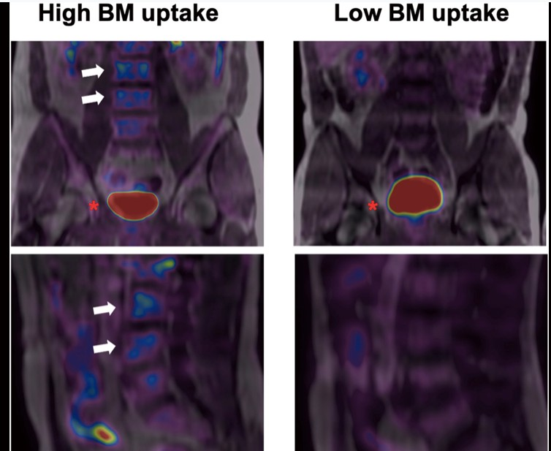
Baseline characteristics of subjects in relation to bone marrow activation
Bone marrow uptake. Representative baseline 18F- fluorodeoxyglucose positron emission tomography/magnetic resonance imaging scans from participants. The left panel shows fused 18F-fluorodeoxyglucose positron emission tomography/magnetic resonance imaging in coronal (upper) and sagittal (lower) views. L3 and L4 vertebrae (white arrows) present high 18F-fluorodeoxyglucose uptake (visualized in blue). The right panel shows the same coronal and sagittal views; 18F-fluorodeoxyglucose uptake is not visualized. The bladder is visualized in red in both upper panels (red asterisk).

Slide 4
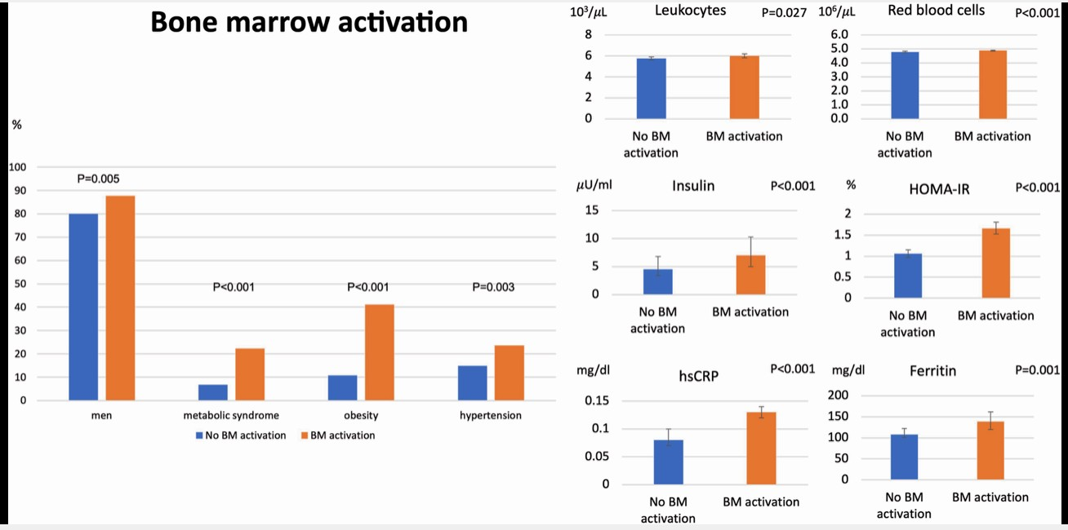
Baseline characteristics of subjects in relation to bone marrow activation
Population with bone marrow activation. Characteristics of participants with baseline bone marrow 18F- fluorodeoxyglucose uptake compared with the group without bone marrow uptake. Participants with bone marrow 18F-fluorodeoxyglucose uptake were more frequently male and had a higher prevalence of metabolic syndrome and its components, central obesity, hypertension, and altered glucose metabolism. The bone marrow uptake group also had higher levels of systemic inflammatory markers (high-sensitivity C-reactive protein and ferritin) and showed higher counts of leucocytes and red blood cells.

Slide 5
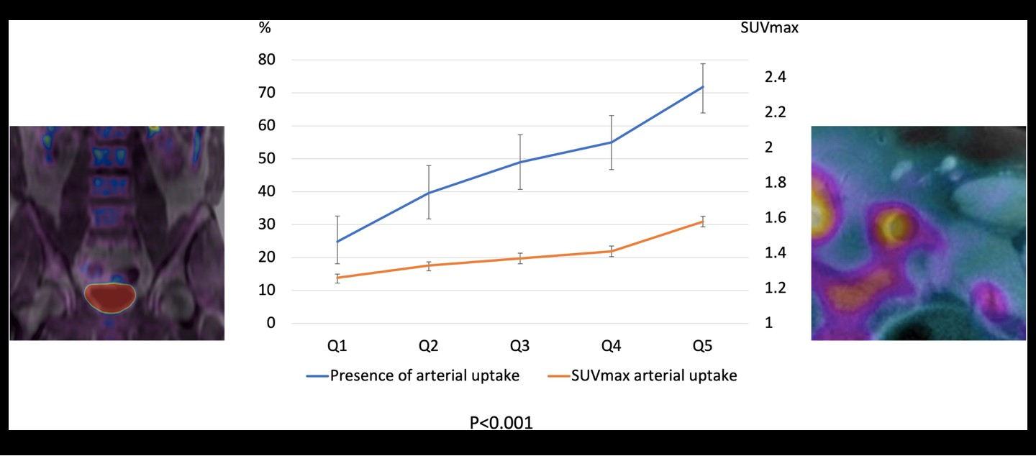
Association between bone marrow activation and early atherosclerosis
Relationship between bone marrow and vascular 18F-fluorodeoxyglucose uptake. The left and right panels show representative positron emission tomography/magnetic resonance imaging analysis of 18F-fluorodeoxyglucose uptake in lumbar vertebrae and vascular tissue, respectively. The chart shows increases in the presence of vascular uptake (left Y-axis) and in vascular-uptake SUVmax (right Y-axis) with increasing bone marrow uptake quintile.

Slide 6


RESULTS
is associated with MetS and its individual components, as well as with elevated numbers of leucocytes, and systemic inflammation
BM Activation
is associated with high arterial metabolic activity (high arterial ¹⁸F-FDG uptake), a surrogate for macrophage infiltration (i.e. the precursor of atherosclerosis)
the association between BM activation and MetS, and between BM activation and arterial ¹⁸F-FDG uptake is maintained even in the absence of systemic inflammation
co-occurring BM activation and vascular ¹⁸F-FDG uptake were significantly associated with more advanced stages of atherosclerosis (higher plaque prevalence, number of plaques, and plaque burden).
CONCLUSION
In apparently healthy individuals, BM ¹⁸F-FDG uptake is associated with MetS and its components, even in the absence of systemic inflammation, and with elevated counts of circulating leucocytes. Bone marrow activation is associated with early atherosclerosis, characterized by high arterial metabolic activity. Bone marrow activation appears to be an early phenomenon in atherosclerosis development.

