Slide 1

BARIATRIC SURGERY AND CARDIOVASCULAR DISEASE: A SYSTEMATIC REVIEW AND META-ANALYSIS

Slide 2

Introduction
Bariatric surgery is increasingly performed in patients with obesity and reduces CV risk factors,
Its effect on CV disease is not established.
We conducted a systematic review and meta-analysis to evaluate the effect of bariatric surgery on CV outcomes, in accordance with the Preferred Reporting Items for Systematic Reviews and Meta- Analyses guideline.

Slide 3
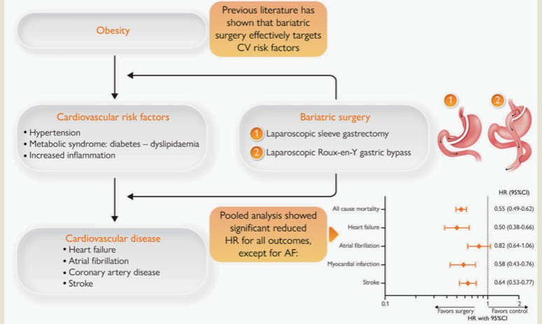
Obesity and cardiovascular disease: the effect of bariatric surgery
This current systematic review and meta-analysis of cohort studies illustrates that all-cause and CV mortality, as well as the incidence of CV
diseases, are reduced by bariatric surgery. Bariatric surgery should therefore be considered in these patients.

Slide 4
Flowchart of literature search according to Preferred Reporting Items for Systematic Reviews and Meta-Analyses guidelines.
BMI, body mass index; CV, cardiovascular

Slide 5
RESULTS
bariatric surgery was also associated with
Bariatric surgery was associated with a
beneficial effect on
all-cause mortality [pooled hazard ratio (HR) of 0.55; 95%
confidence interval (CI) 0.49–0.62, P <
0.001 vs. controls]
myocardial infarction (HR
0.58, 95% CI 0.43–
0.76, P < 0.001) &
stroke (HR 0.64,
95% CI 0.53–0.77,
P < 0.001)
CV mortality (HR 0.59, 95% CI 0.47–
0.73, P < 0.001)
reduced incidence of HF (HR 0.50, 95%
CI 0.38–0.66, P
< 0.001)

Slide 6
CONCLUSION
The present systematic review and meta-analysis suggests that bariatric surgery is associated with reduced all-cause and CV mortality, and lowered incidence of several CV diseases in patients with obesity. Bariatric surgery should therefore be considered in these patients.
Reduced all cause death
Reduced CV mortality
Reduced CV diseases in patient with obesity
----

